Slide 1
A case of a NET of the minor papilla
by En-Ling Leung Ki

Slide 2
A 70 years old lady underwent a CT scan for abdominal pain, with findings of a hyper vascular lesion in D2 .
EUS was performed showing a normal papilla and a well circumscribed, hyperechoic lesion of the minor papilla with a dilated Santorini duct. EUS FNB confirmed this was a minor papilla low grade NET.

Slide 3
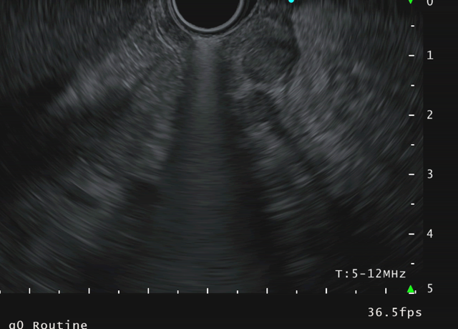

Slide 4
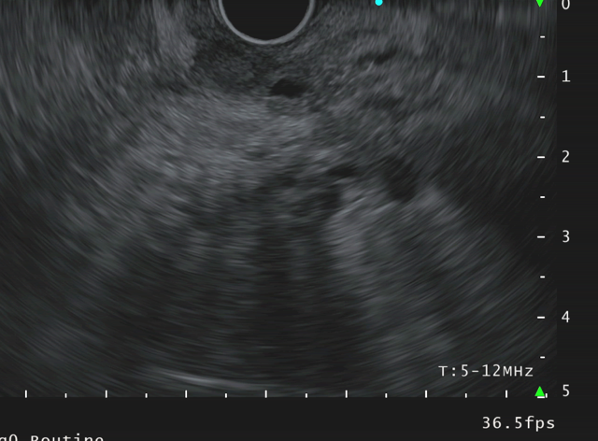

Slide 5
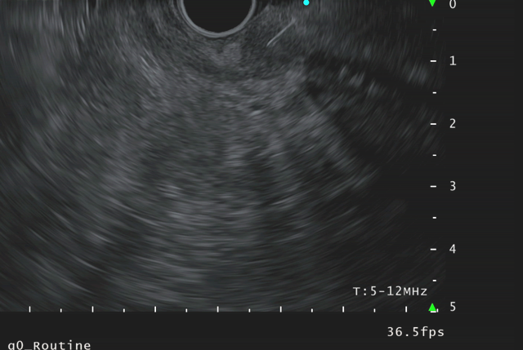

Slide 6
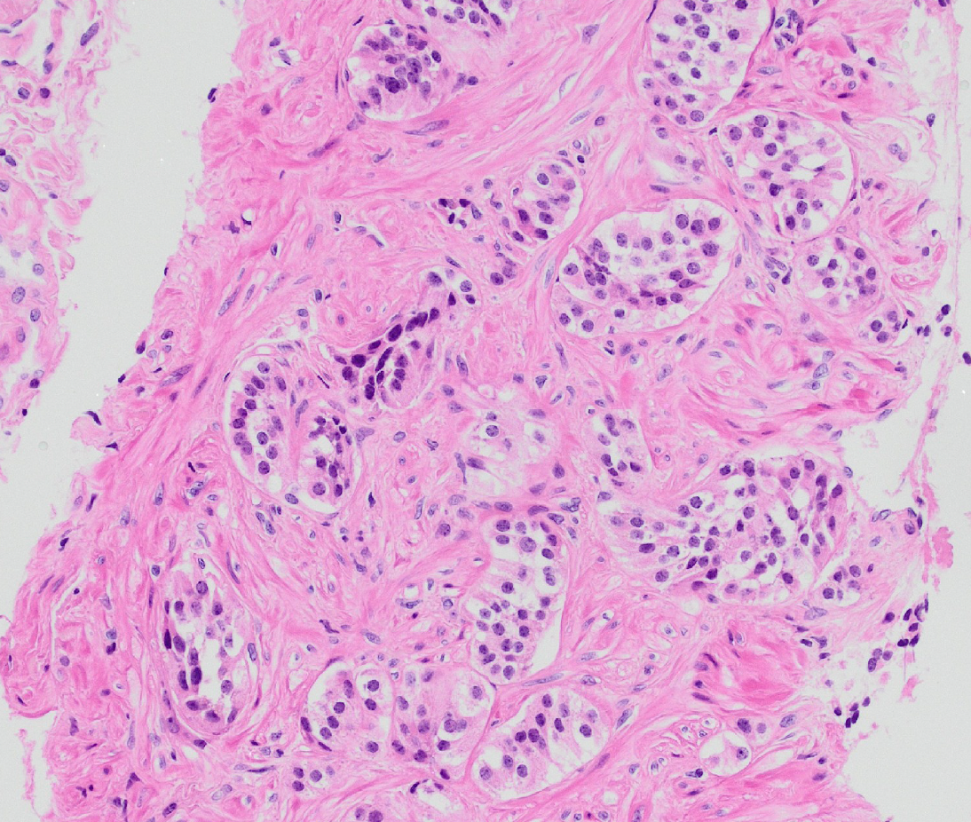

Slide 7
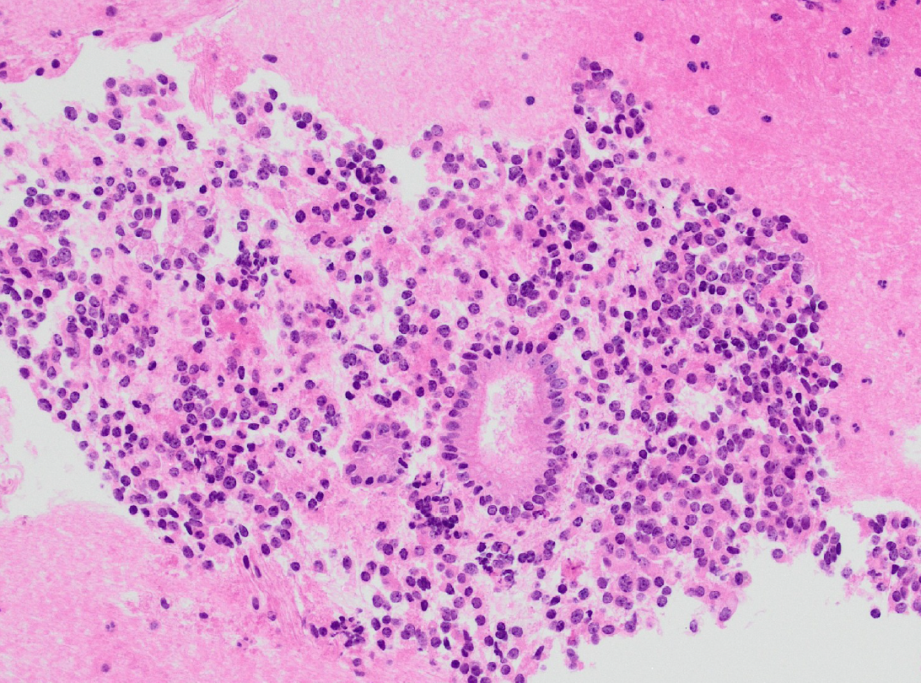

Slide 8
