Slide 1
Main-type IPMN invading
the gastric antrum
Mauro BRUNO
Turin

Slide 2
72 yo man
onset of diabetes 3 years before referral
because of epigastric discomfort, nausea and a 5 Kg weight loss he underwent US and CT

Slide 3


Slide 4
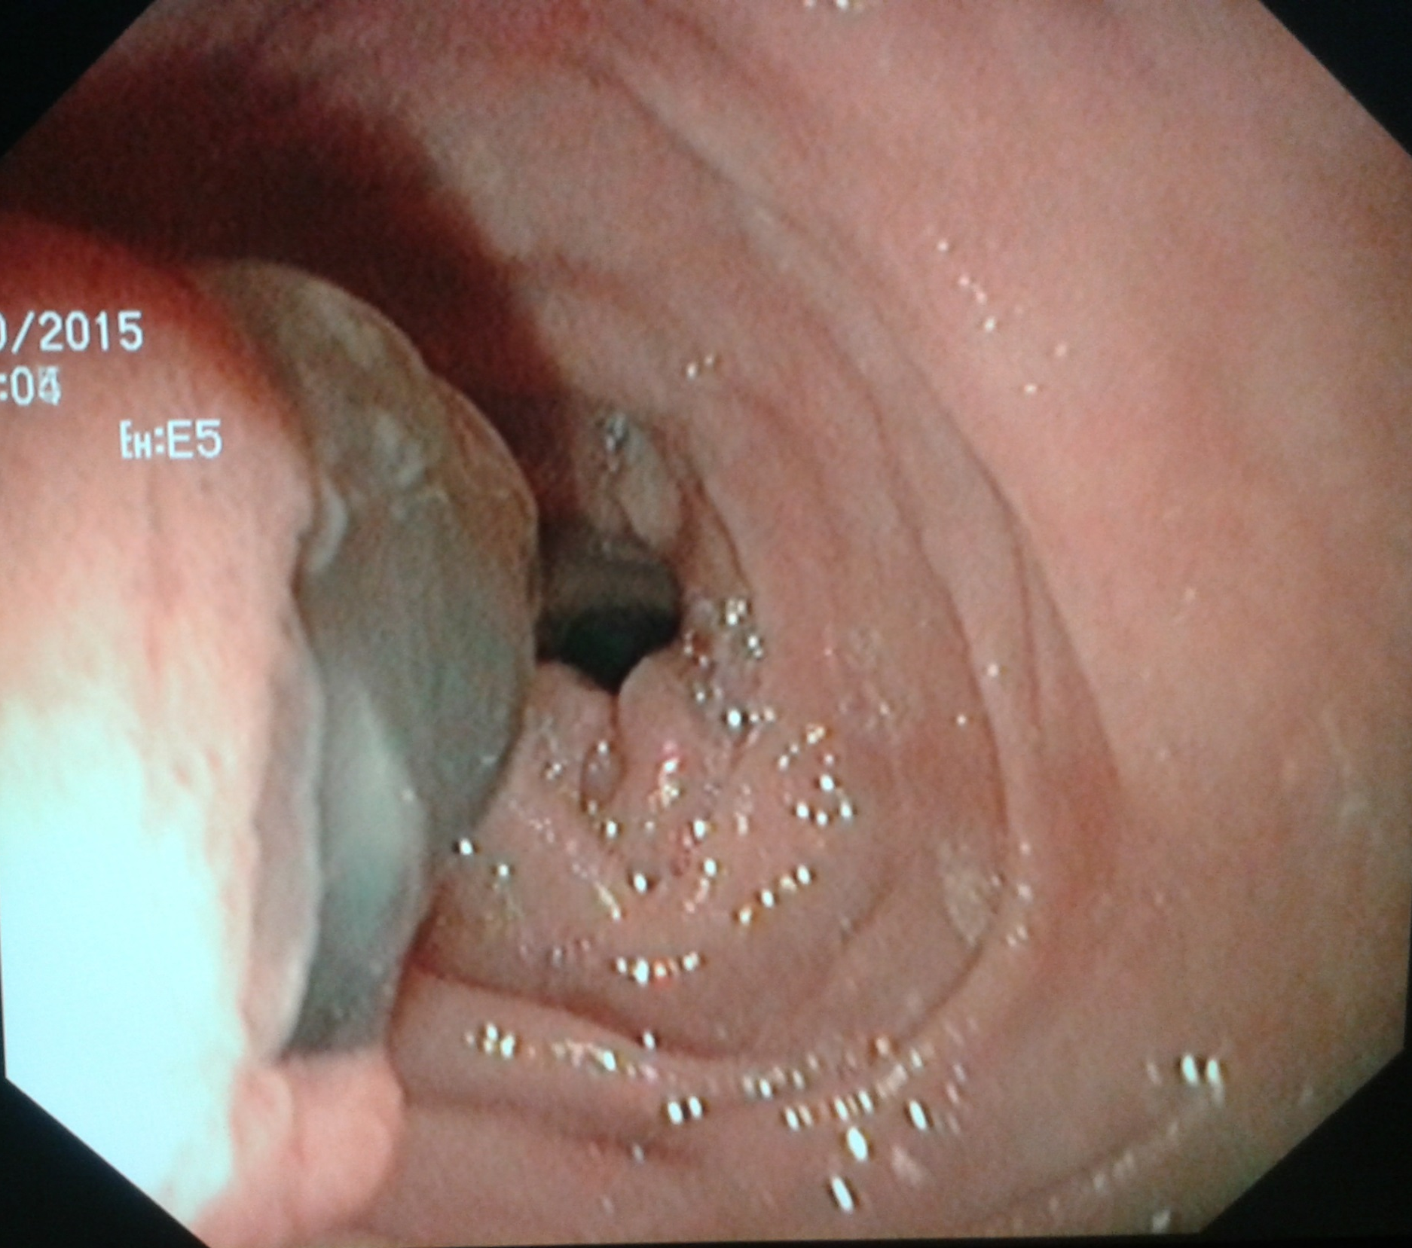

Slide 5
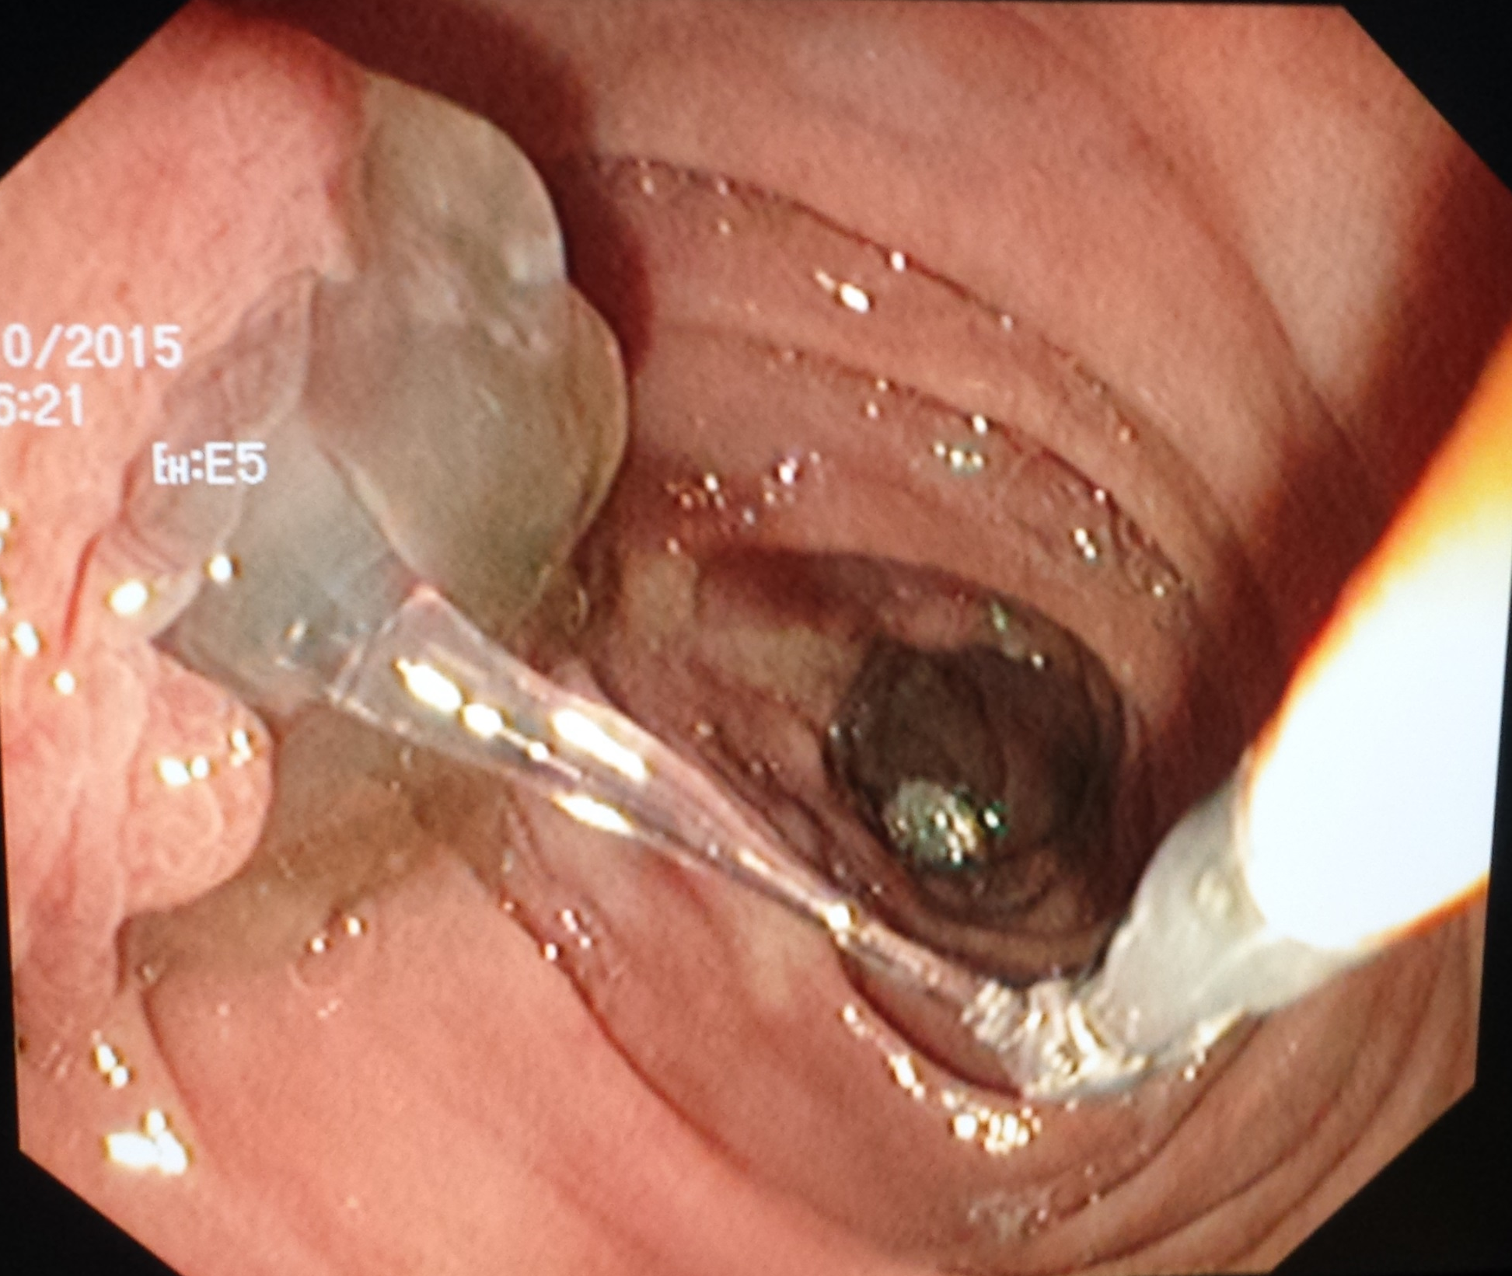
Mucus from the major papilla

Slide 6
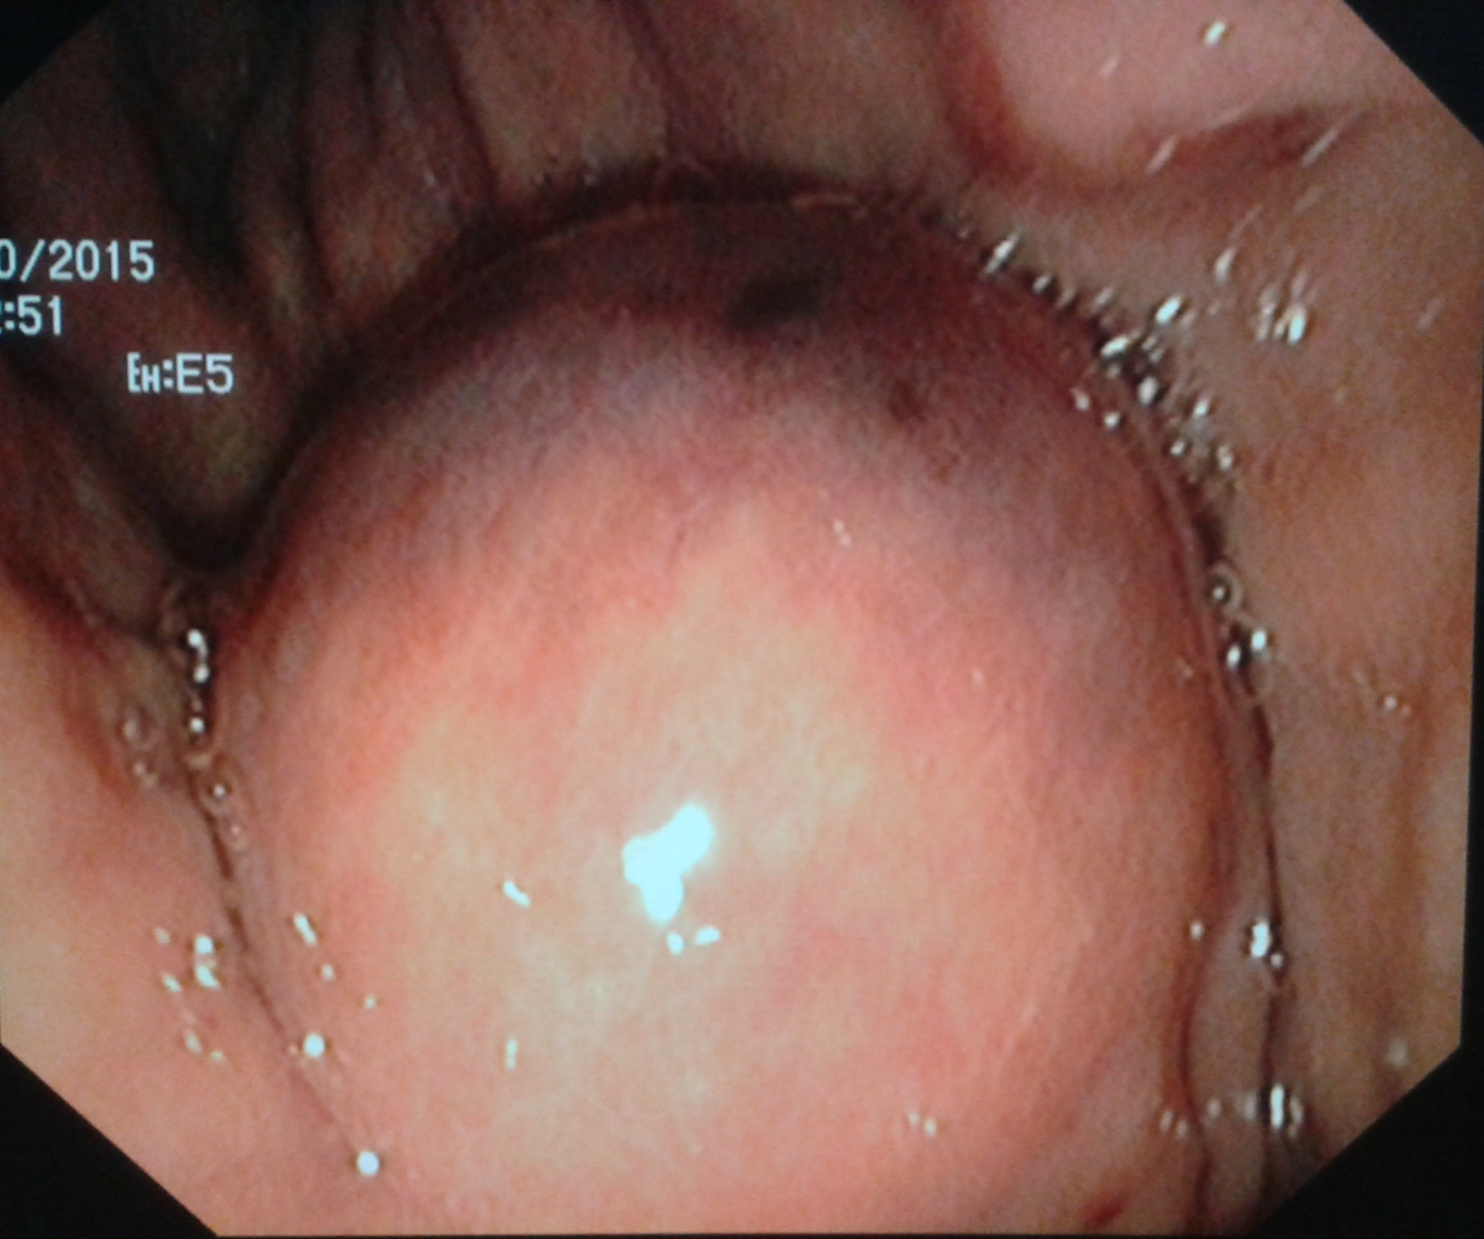
A bulging was seen in the antrum

Slide 7
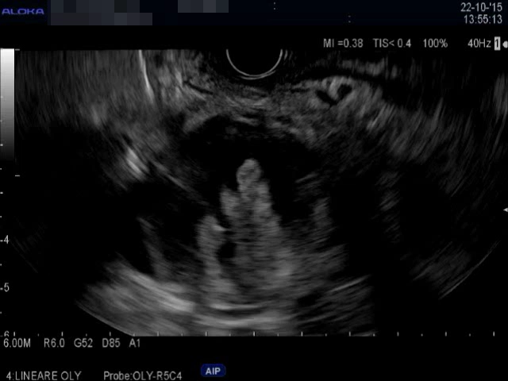

Slide 8
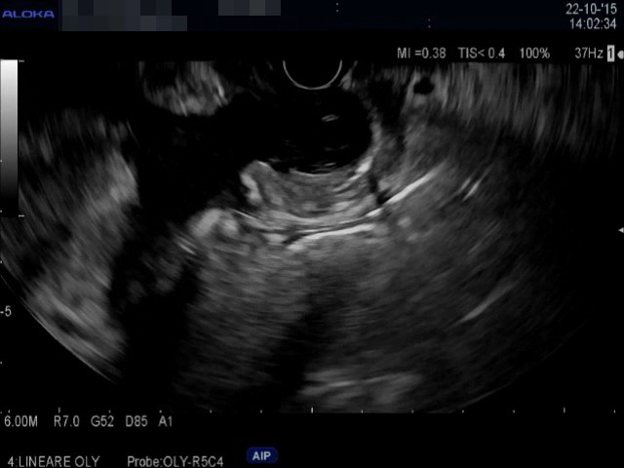
*
IPMN fistulizing in the antrum

Slide 9


Slide 10
