Slide 1
A case of a Wirsung duct dilation
by En-Ling Leung Ki

Slide 2
A 55 years old obese smoker man underwent a CT scan for a suspected renal stone; a dilation of the Wirsung duct was noted.
EUS displayed a fish-eye papilla, a diffusely dilated Wirsung duct (up to 13 mm) filled with echoic material, and a 3 cm mass in the pancreatic head (FNB confirmed a ductal adenocarcinoma).
The patient underwent a pancreatic resection, that confirmed a main duct type IPMN associated with an adenocarcinoma of the head.

Slide 3
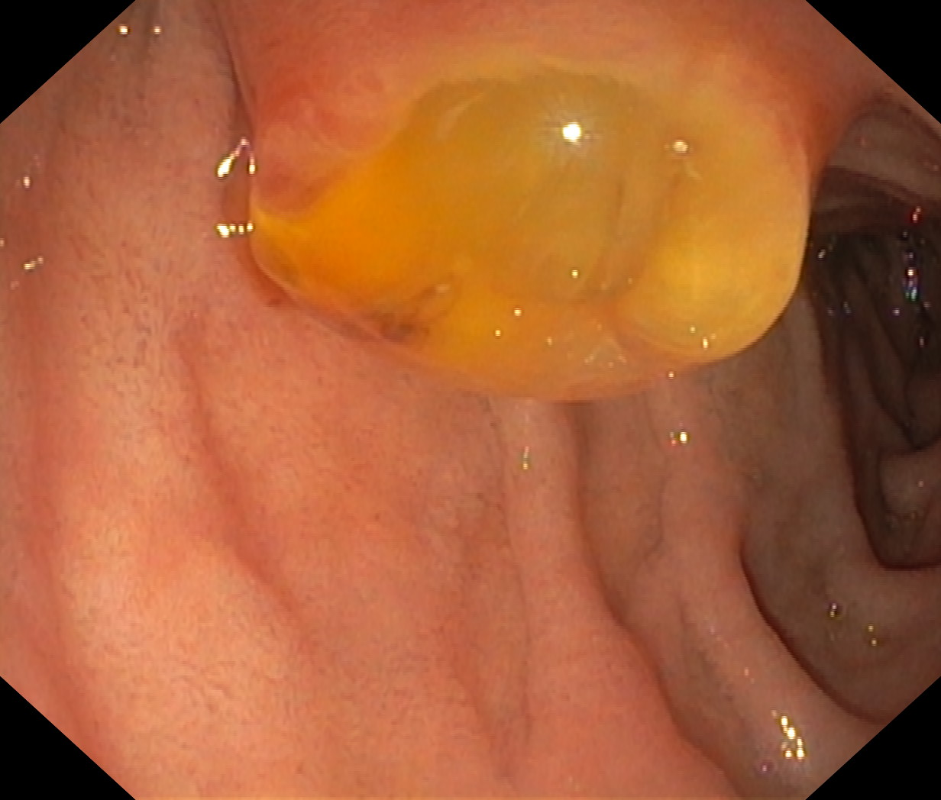

Slide 4
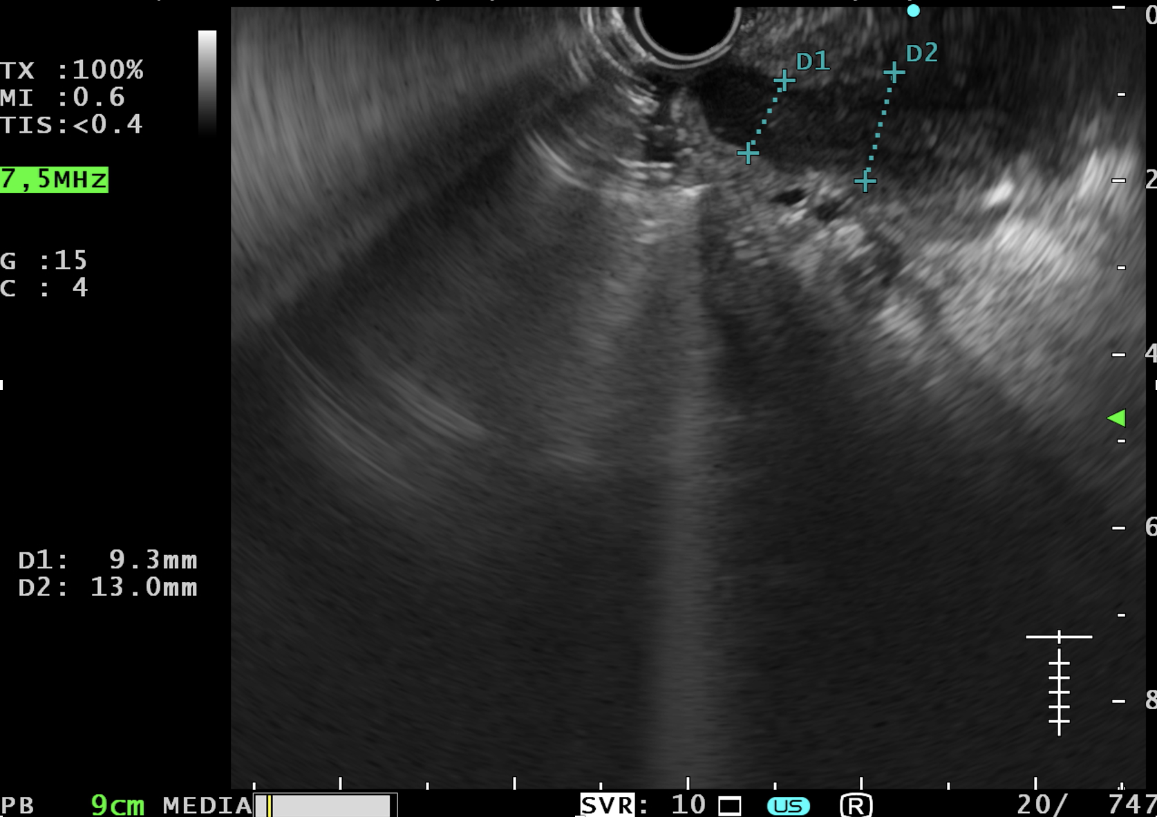

Slide 5
