Slide 1
A case of a cyst in the tail of the pancreas
by En-Ling Leung Ki

Slide 2
A 40 years old asymptomatic woman underwent a CT scan after an accident; a 5 cm cyst in the tail of the pancreas was seen, with no dilation of the Wirsung duct.
EUS displayed a macrocystic multilocular lesion in the tail of the pancreas; neither its external wall nor the inner septae showed vascularization after Sonovue injection; the rest of the pancreas was normal. A 19G needle FNB showed high CEA, low glucose, equivocal amylase, likely high grade dysplasia at cytology.
The patient underwent a distal pancreatic resection, that showed a mucinous cystadenoma with low grade dysplasia.

Slide 3
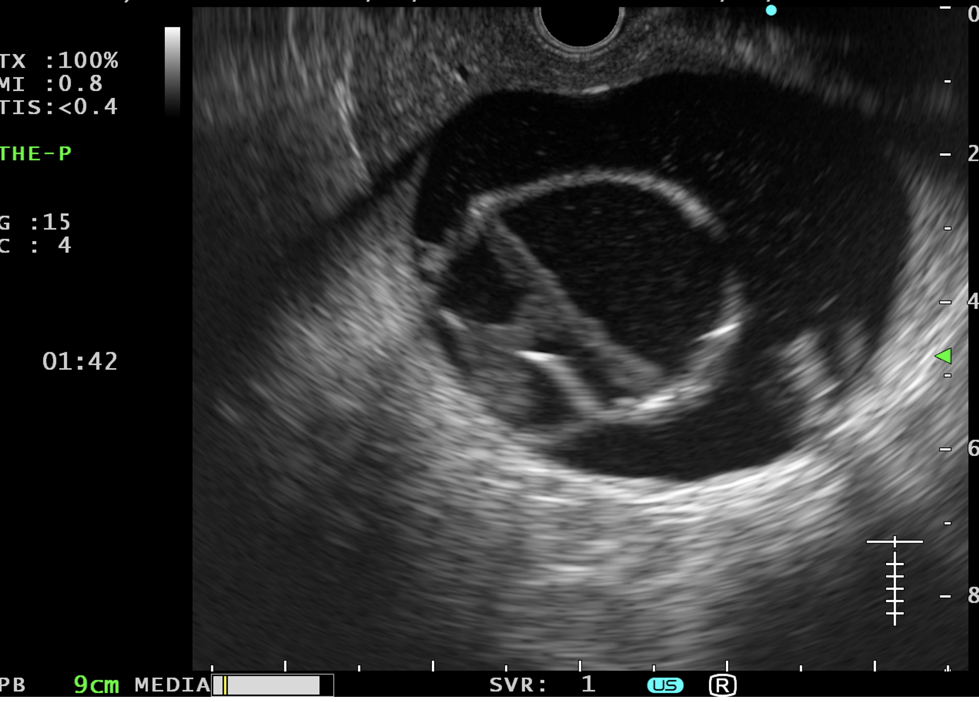

Slide 4
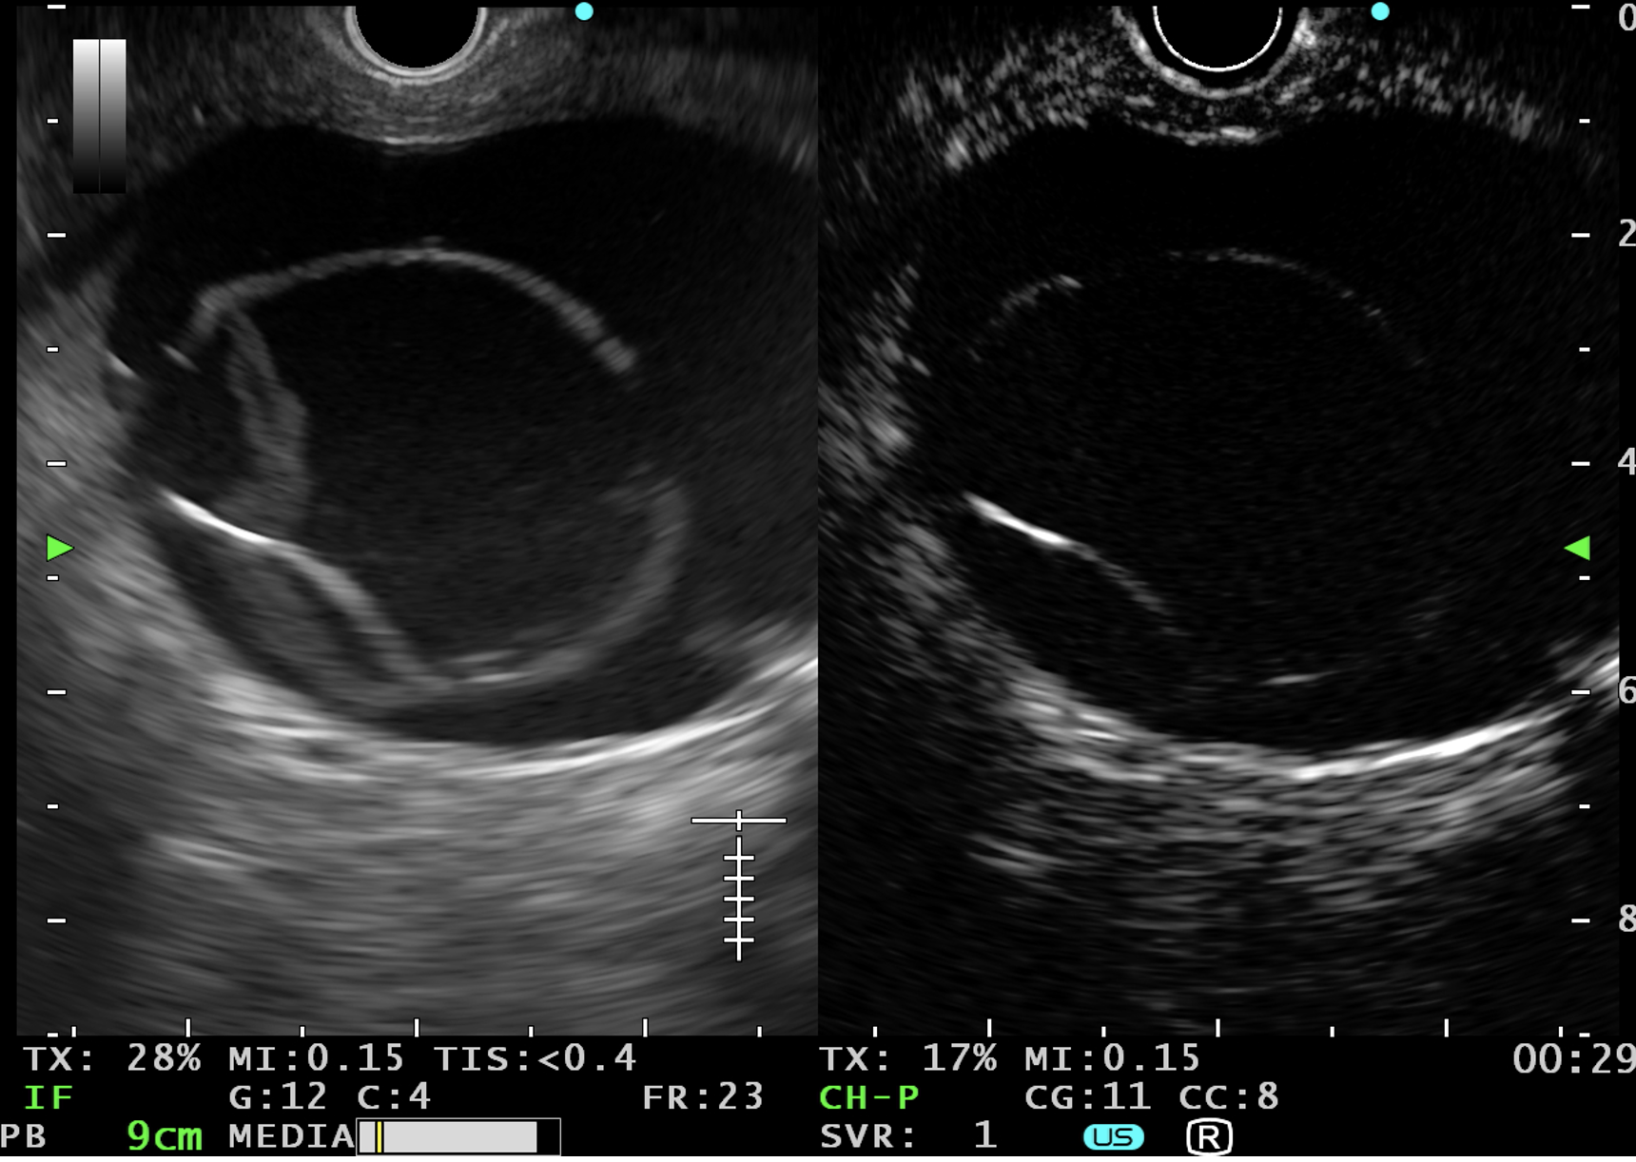
arterial phase

Slide 5
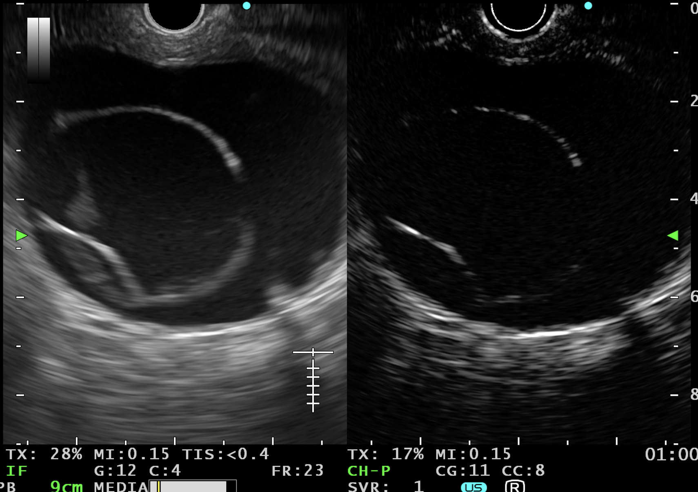
venous phase

