Slide 1
EUS of the Anorectum and Pelvis: Indications, anatomy and practical tips
Mauro BRUNO
Turin

Slide 2
Indications
Staging of rectal/anal cancer
Notes:
SICCR societa’ italiana chirurgia colorettale / ci sono differenze a seconda della sede delal fistola ma non impattano nel complesso . Occhio a proctiti

Slide 3
Indications
Staging of rectal/anal cancer
Evaluation of fistulas/abscesses
# Literature is difficult to interpret due to heterogeneity (Crohn vs non-Crohn, H₂O₂, different processors and probes)
# SICCR 2020: endorectal ultrasound (3D) and MRI should be the first-line imaging techniques
# Do it if you know how and MRI access is limited in your setting. Prefer rigid probes and 3D modality. Use H₂O₂

Slide 4
Indications
Staging of rectal/anal cancer
Evaluation of fistulas/abscesses
Incontinence work-up
Morphological evaluation is complementary to functional studies (manometry, EMG, etc.)
IAS (internal anal sphincter): 2–3 mm (with age → thicker and more echogenic)
EAS (external anal sphincter): 7–9 mm (with age → thinner and more blurred)
Do not confuse anatomical variants with disease (!) [EAS opens anteriorly in women; beware of the anococcygeal ligament]
EUS vs MRI: MRI is better for EAS; EUS is more accurate for IAS

Slide 5
Indications
Staging of rectal/anal cancer
Evaluation of fistulas/abscesses
Incontinence work-up
Diagnosis and staging of subepithelial lesions
Endometriosis
IBD
Diagnosis … but also therapy !
Drainage of pelvic abscesses
Placement of fiducials
Treatment of rectal varices
Neurolysis/block of the superior hypogastric plexus
Notes:
SICCR societa’ italiana chirurgia colorettale / ci sono differenze a seconda della sede delal fistola ma non impattano nel complesso . Occhio a proctiti

Slide 6
Practical aspects
Rectal cleansing is usually enough
Which probe?
Start in left lateral decubitus (but change if needed)
Be sure you know what you have to stage (repeat proctoscopy if needed)
Sedation is usually unnecessary
Carefully aspirate air and stool, distend with water (200–250 mL)
Orthogonal scanning to avoid artifacts
Notes:
SICCR societa’ italiana chirurgia colorettale / ci sono differenze a seconda della sede delal fistola ma non impattano nel complesso . Occhio a proctiti

Slide 8
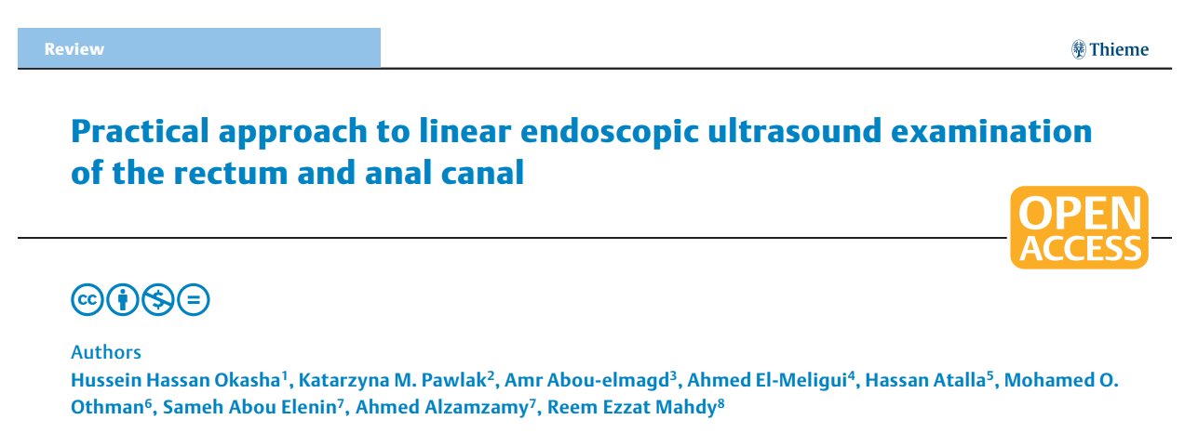
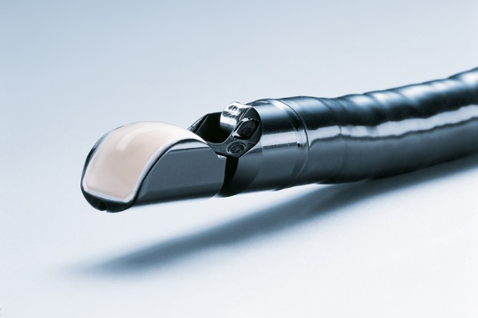
Practical aspects
Rectal cleansing is usually enough
Which probe?
Start in left lateral decubitus (but change if needed)
Be sure you know what you have to stage (repeat proctoscopy if needed)
Sedation is usually unnecessary
Carefully aspirate air and stool, distend with water (200–250 mL)
Orthogonal scanning to avoid artifacts
If you prefer the linear scope …
Endosc Int Open 2022; 10: E1417–E1426
Notes:
SICCR societa’ italiana chirurgia colorettale / ci sono differenze a seconda della sede delal fistola ma non impattano nel complesso . Occhio a proctiti

Slide 9
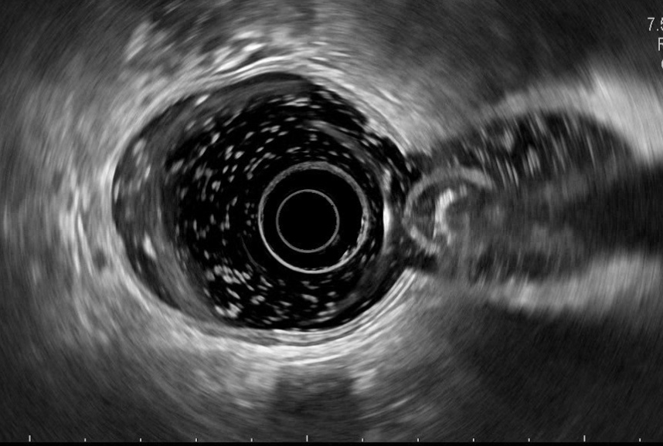
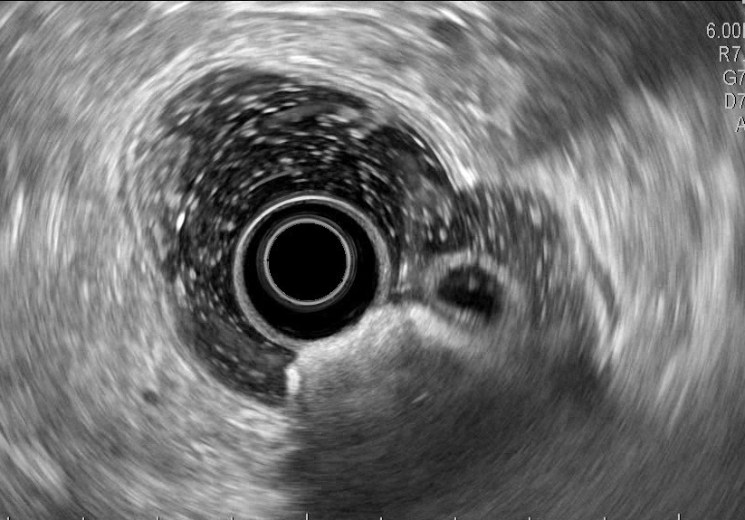
Practical aspects
Rectal cleansing is usually enough
Which probe?
Start in left lateral decubitus (but change if needed)
Be sure you know what you have to stage (repeat proctoscopy if needed)
Sedation is usually unnecessary
Carefully aspirate air and stool, distend with water (200–250 mL)
Orthogonal scanning to avoid artifacts
Notes:
SICCR societa’ italiana chirurgia colorettale / ci sono differenze a seconda della sede delal fistola ma non impattano nel complesso . Occhio a proctiti

Slide 10
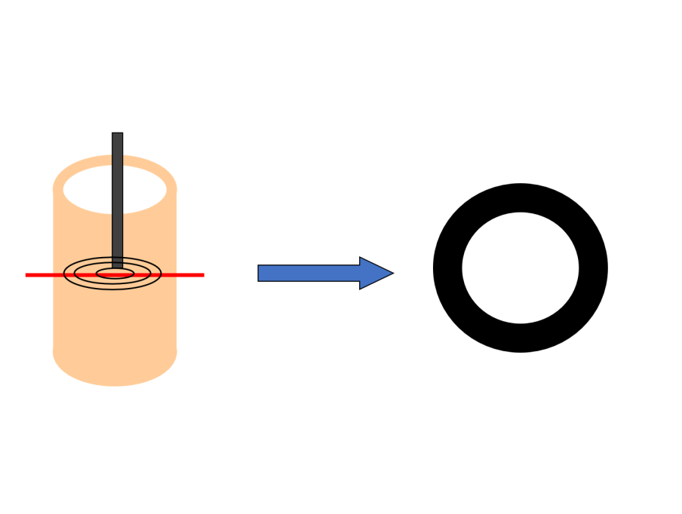
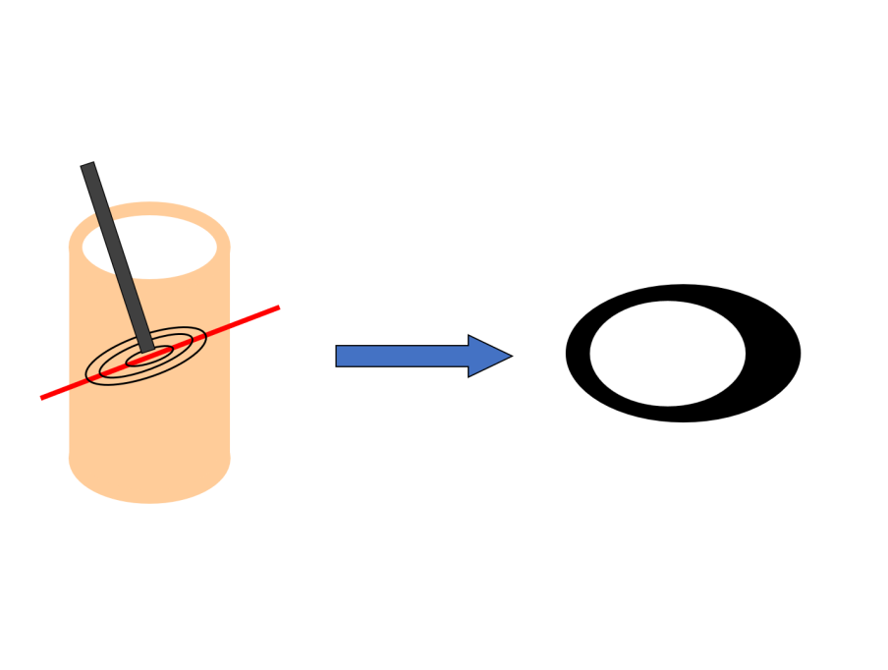
Practical aspects
Rectal cleansing is usually enough
Which probe?
Start in left lateral decubitus (but change if needed)
Be sure you know what you have to stage (repeat proctoscopy if needed)
Sedation is usually unnecessary
Carefully aspirate air and stool, distend with water (200–250 mL)
Orthogonal scanning to avoid artifacts
Notes:
SICCR societa’ italiana chirurgia colorettale / ci sono differenze a seconda della sede delal fistola ma non impattano nel complesso . Occhio a proctiti

Slide 11
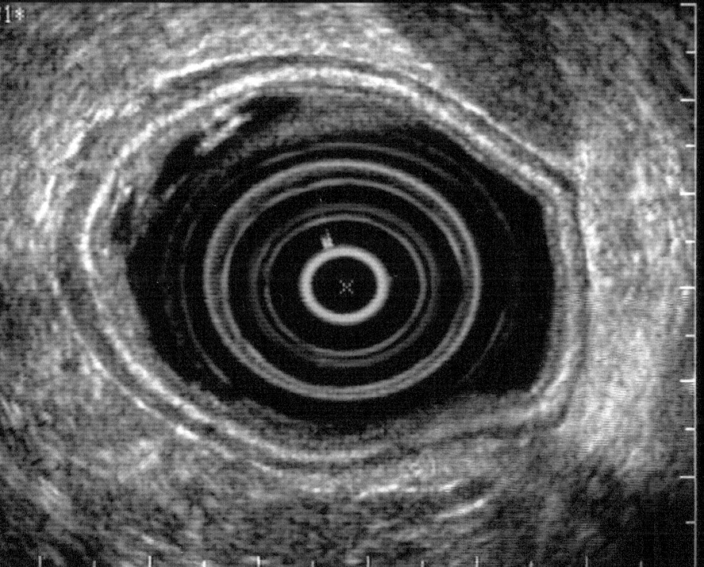
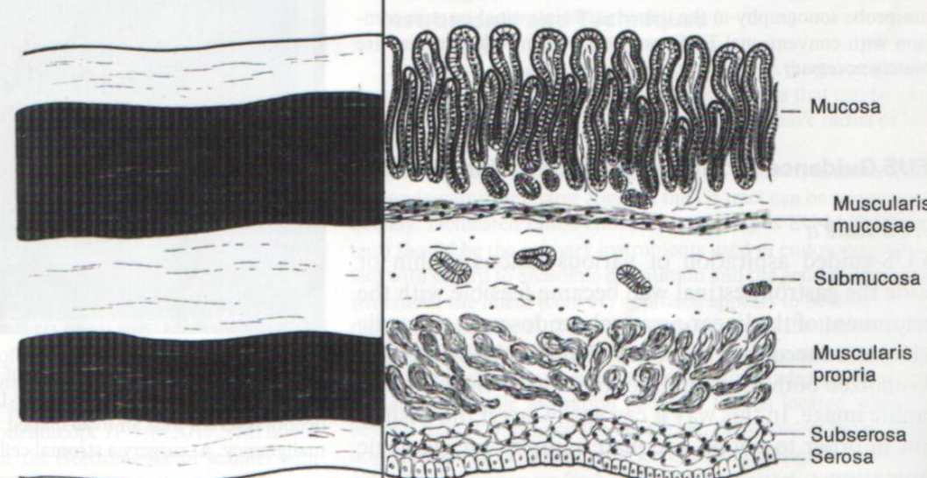
Let the exploration begin!
Insert the scope up to the mid-sigmoid colon (about 30 cm from the anus)
First anatomical landmark: vessels (aorta/IVC or common iliac vessels)
Start retracting the instrument
Typically, a 5-layered wall can be observed

Slide 12
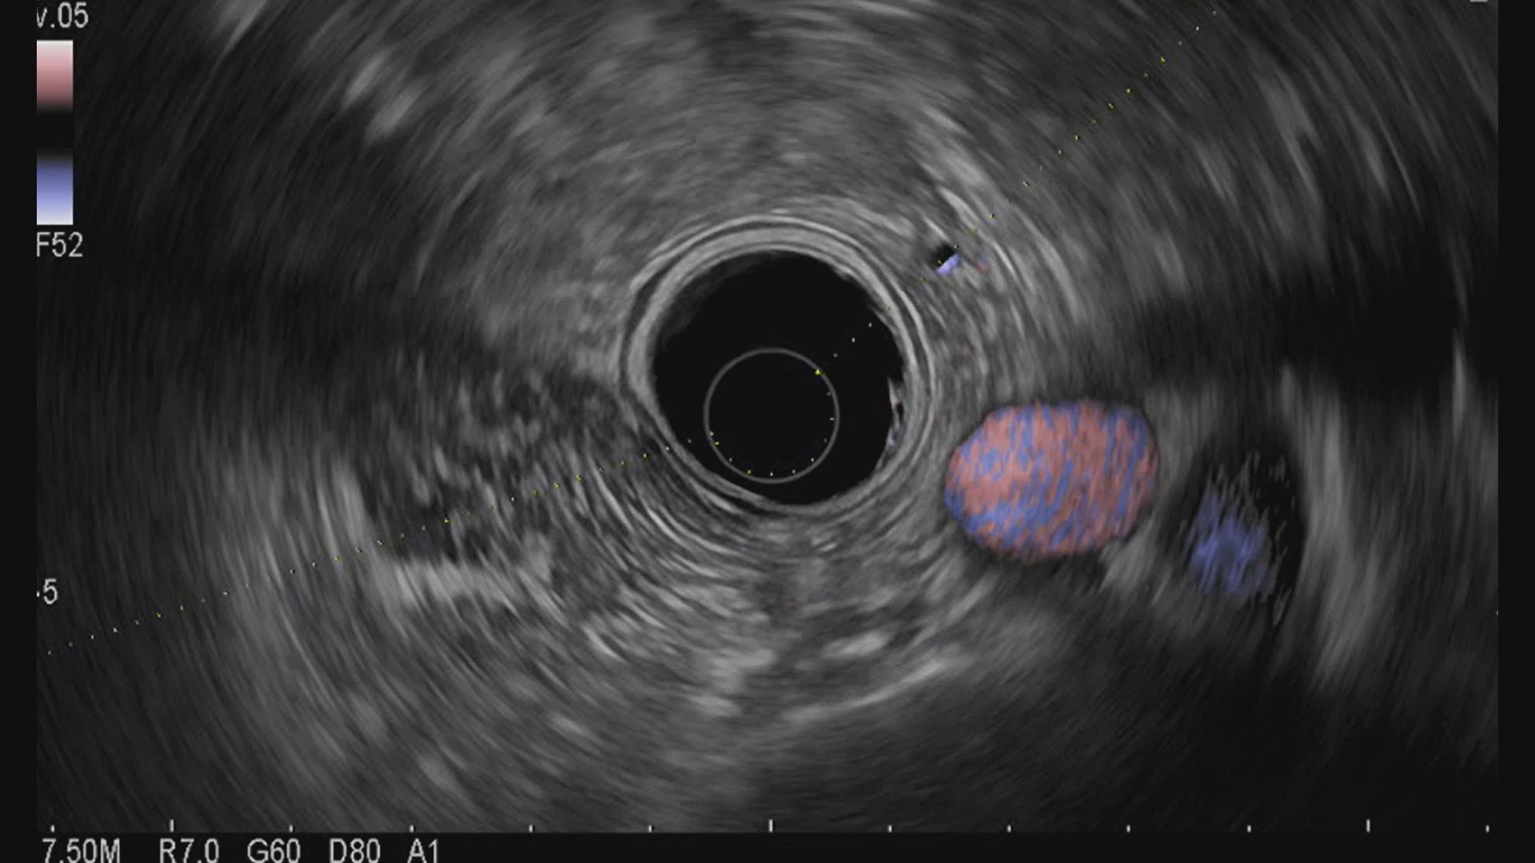
IVC
Aorta
Spine

Slide 13
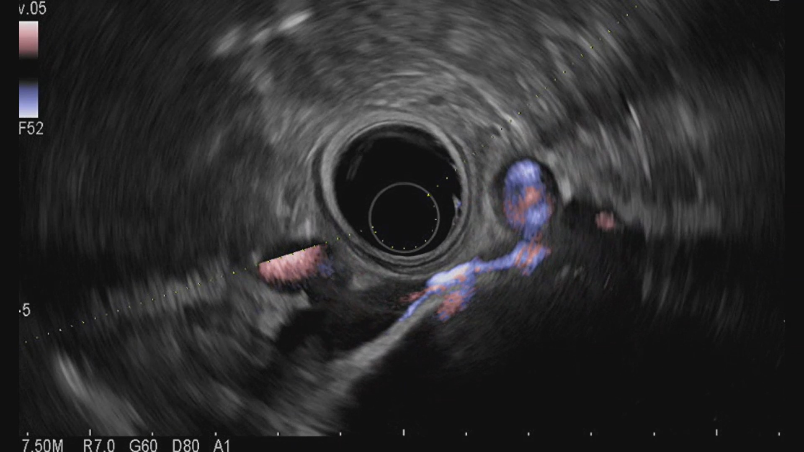
Sx
Dx
Common iliac artery
Common iliac artery
Common iliac vein
Common iliac vein
Spine

Slide 14
IVC
Aorta
L4
Common iliac vessels
L5-S1
External iliac vessels
Internal iliac vessels

Slide 15
IVC
Aorta
L4
Common iliac vessels
L5-S1
External iliac vessels
Internal iliac vessels

Slide 16
IVC
Aorta
L4
Common iliac vessels
L5-S1
External iliac vessels
Internal iliac vessels

Slide 17
Male pelvis

Slide 18
Male pelvis

Slide 19
Female pelvis

Slide 20
Don’t Forget the Anal Canal!
rectum
m. puborectalis
anus
internal sphincter
external sphincter

Slide 21
Don’t Forget the Anal Canal!
rectum
1
anus
2
3

Slide 22
*
*
Level 1: Upper third

Slide 23
*
*
*
*
Level 1: Upper third
Levator ani muscle
*
IAS
*
EAS

Slide 24
*
Level 2: Middle third

Slide 25
Level 3: Lower third
(only the EAS
is present)

Slide 26
Remember that with EUS …
The peritoneal reflection cannot be identified
Visualization of the mesorectal fascia is extremely rare
Benign lymph nodes in the mesorectum are usually < 3 mm and isoechoic, beware of larger lymph nodes, thay may be metastatic!
The End

